Slide 1
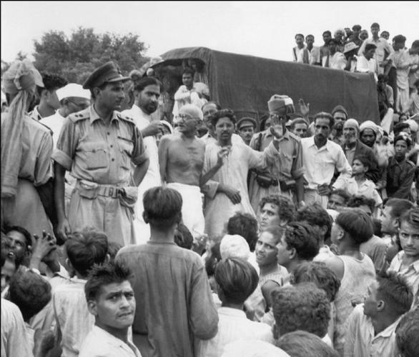
English presentation
HERO OF CHAMPARAN

Slide 2
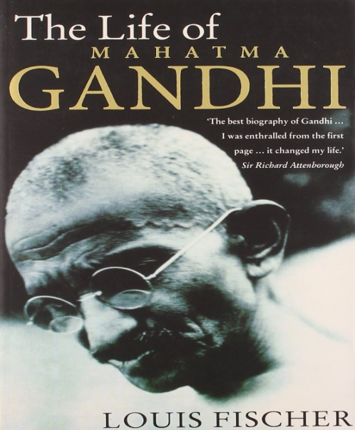
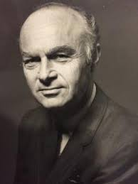
INDIGO
Louis Fischer was born in Philadelphia (1896-1970)
He served as a volunteer in British army between 1918 and 1920.
He made a career as a journalist and wrote for The new york times, The Saturday review and for European and Asian publications.
The following is an excerpt from his book- The life of Mahatma Gandhi . The book has been reviewed as one of the best books ever written on Gandhi.

Slide 3
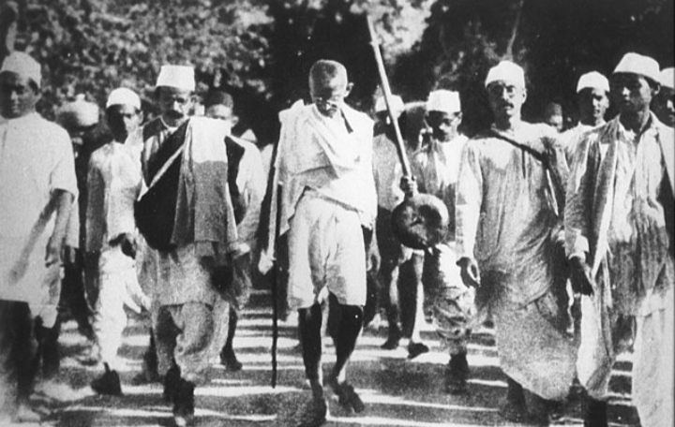
Theme -
The leadership shown by Mahatma Gandhi to secure justice oppressed people through convincing argumentation.
SUB-THEME -
Contribution made by anonymous Indians to the freedom movement.
PLOT –
Shukla’s meeting with gandhi
– problems of the sharecroppers-
gandhi’s visit to chamaparan an route
muzzafarpur- patna episode- motihari
episode – tirhut episode-court
episode- attitude-of lawyers-
settlement of dispute – social upliftment
– lesson on self-reliance

Slide 4
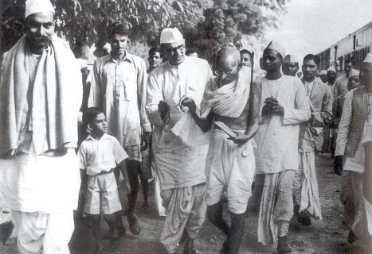
Characters – (champaran episode)
Gandhi
Raj kumar shukla
Lawyers
Kripalni
Malkani
Servants of Rajendra Prasad
Maltreated farmer
Peasants
British officials
Kasturbai Gandhi

Slide 5
introduction
The account is based on the interview taken by Louis Fischer on Mahatma Gandhi. In order to write on him he had visited him in 1942 at his ashram- Sevagram where he was told about the Indigo Movement started by Gandhiji. The story revolves around the struggle of Gandhi and other prominent leaders in order to safeguard sharecroppers from the atrocities of landlords. "Indigo" portraits Gandhiji's struggle for the poor peasants of Champaran. He managed to get justice after a yearlong battle for the peasants. He also made arrangements for the education, health and hygiene for the families of the poor peasants. He gave them the lesson of self-reliance.

Slide 6
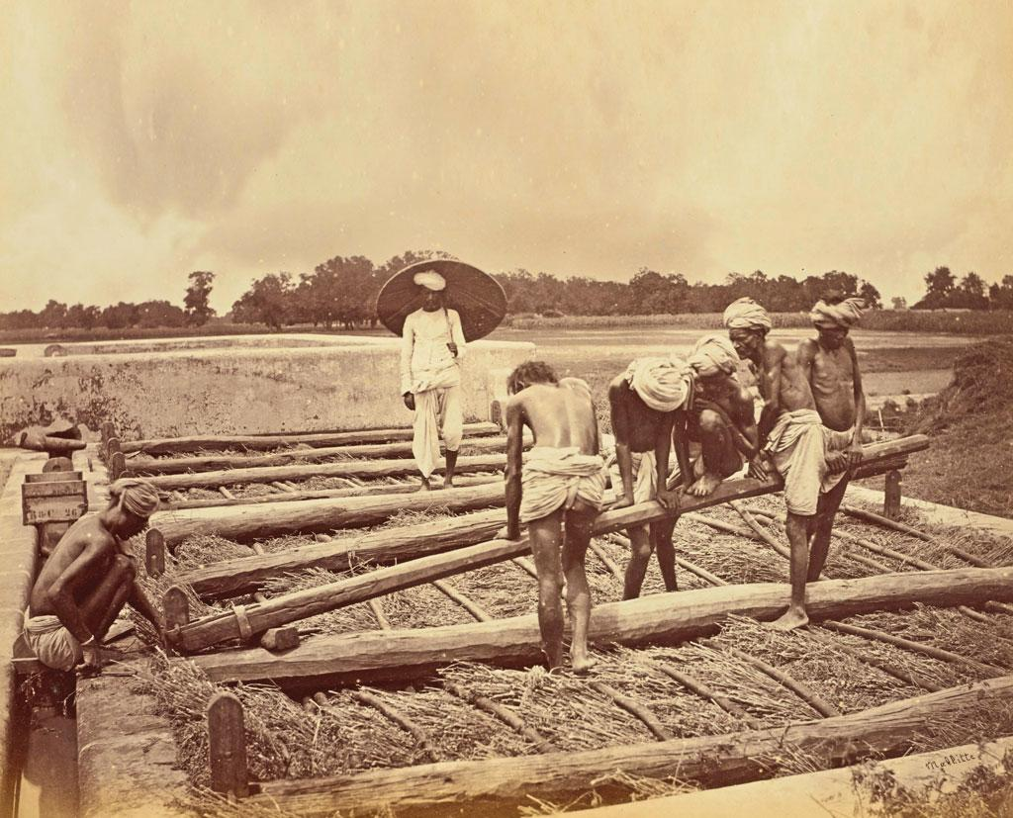

Slide 7
summary
The story ‘Indigo’, written by Louis Fischer narrates Gandhiji’s struggle for the poor peasants of Champaran. The peasants were sharecroppers with the British planters. According to an old agreement, the peasants had to produce indigo on 15 per cent of the land and give it as rent to the landlords. Around 1917, it was told that Germany had developed synthetic indigo. So the British planters now no longer desired the indigo crop. To release the peasants from the old 15 per cent agreement, they demanded compensation from them. Most of the illiterate peasants agreed to it.

Slide 8
However, others refused. Lawyers were engaged to go to the court. At that time, on the request of Rajkumar Shukla a sharecropper, Gandhiji appeared in Champaran. He fought for the poor peasants a long battle for one year and managed to get justice for them. The peasants now got courage and became aware of their rights. Along with the political and economic struggle, Gandhiji worked on the social level also. He made arrangements for the education, health and hygiene of the families of poor peasants by teaching the lesson of self¬reliance. It was one of the ways to forward the struggle for Indian independence.

Slide 9
Self reliance
noun
meaning : reliance on one's own powers and resources rather than those of others.
Similar:
self-sufficiency
self-support
self-sustenance
self-standing
independence

Slide 10
Main characters in the text
- Indigo

Slide 11
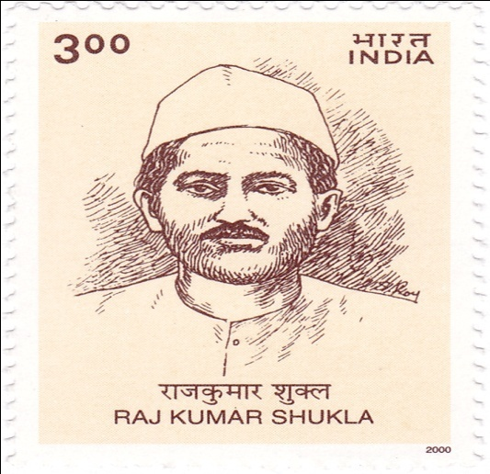
Raj kumar shukla ( peasant )
Rajkumar Shukla was a poor sharecropper who was a victim of British landlords. Though he was illiterate, he was determined to fight against the injustice of the British landlords, and to fight them, he goes to meet Gandhiji to seek his help. It was because of Rajkumar Shukla that Gandhiji came to Champaran village in Bihar. Later, this struggle with British landlords became a turning point in the fight for the independence of India.

Slide 12
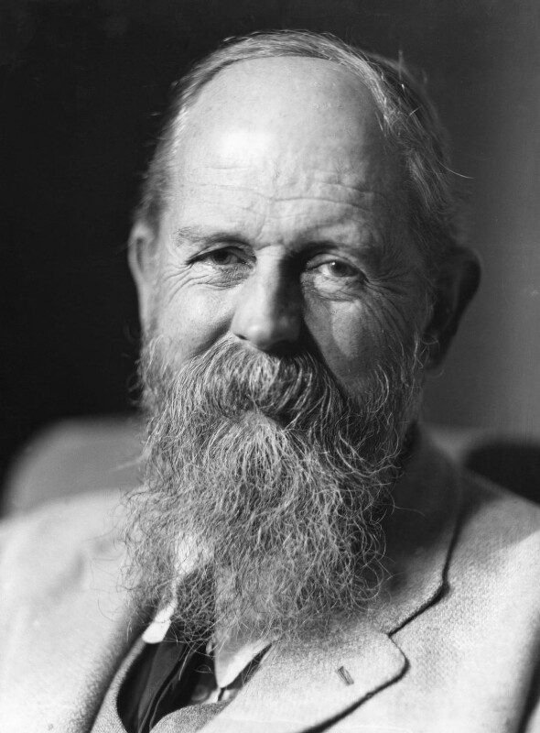
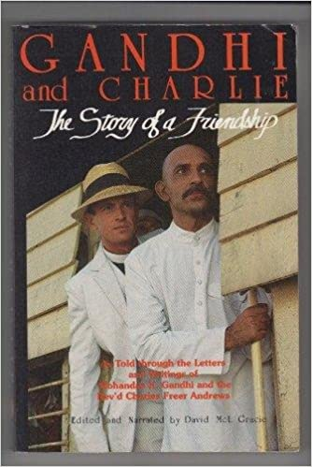
Charles freer andrews (g’s devotee)
Charles Freer Andrews was an English pacifist who became a devoted follower of Gandhi. He came to bid farewell to Gandhi before going on a tour to Fizi islands. Gandhi’s lawyer friends insisted him to stay and help them in the battle, but Gandhiji strongly opposed saying that they must not rely on an Englishman but on themselves to win the battle.

Slide 13
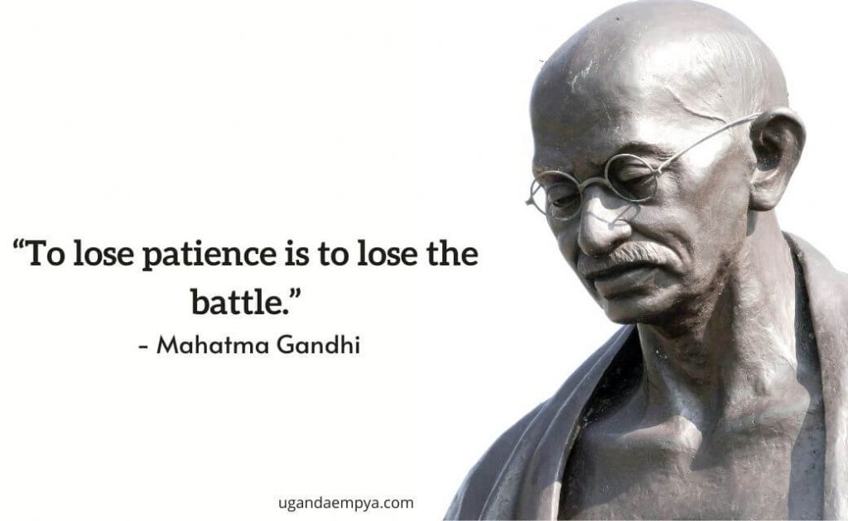
Mahatma gandhi
Mohandas Karamchand Gandhi, known as Mahatma Gandhi was a highly intelligent and perceptive man. His fundamental principles were non-violence and self-reliance. His entire political campaign for the development of the country was based on these two principles. CHAMPARAN MOVEMENT “ AN INCIDENT WHEN MOHANDAS BECAME MAHATMA “

Slide 14
INDIGO PLANTERS
( SHARE CROPPERS )

Slide 15

INDIGO REVOLT
“DYE
STAINED
WITH
HUMAN
BLOOD “

Slide 16
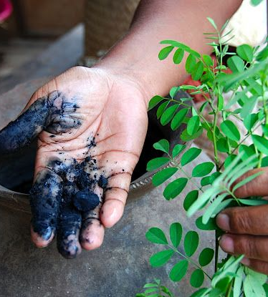
INDIGO REVOLT
“
THEY
SAY THAT
THE
COLOUR OF
REVOLUTION
IS RED. NOT
ALWAYS.
SOMETIMES
IT’S BLUE
“

Slide 17
MESSAGE
Patience, perseverance and determination - help one overcome all odds and adversities.
While managing crisis - focus on solution rather than problem.
Be self-reliant instead of looking for shoulders to lean upon.
Important –- teach people courage and fight own battles- independently and fearlessly- rather than lending support in critical situations

Slide 18
GLOSSARY
RECONVENED - met again after a break.
RESOLUTE - determined.
SHARECROPPER FARMERS WHO GIVE PART OF - their crop as rent to the owner.
CIVIL WAR - a conflict between two groups within the same country.
EXTORTED - obtained by using force or threats.

